Slide 1
NEW WRITING UNIT=FICTION
Notes:
Hello writers! Today is an exciting day because we are beginning an exciting new unit. For the next few weeks we will be writing fiction. I want you to think about what fiction means… if there is someone in the room, turn and tell them what you think fiction means.

Slide 2
WHAT DOES FICTION MEAN?
FICTION MEAN FALSE OR NOT TRUE
AN EXAMPLE WOULD BE FAIRY TALES OR MAKE-BELIEVE STORIES
Notes:
Nice work, fiction writing means false or not true. The first type of fiction writing we will be doing is writing make-believe stories. Make believe stories are pretend stories that come from a writer’s imagination. These stories couldn’t happen in real life. One example of a make-believe story is a fairy tale. Can you think of any Fairy tales?

Slide 3
WHAT ARE SOME FAIRY TALES YOU KNOW?
CINDERELLA
LITTLE RED RIDING HOOD
JACK AND THE BEANSTALK
THE THREE LITTLE PIGS
AND LOTS MORE!
Notes:
Totally! I know some Fairy Tales too! Let’s listen to a read-aloud of Jack and the Beanstalk. Pay attention to what the writer includes in their fairy tale that might be similar to other make-believe stories.

Slide 4
Let’s Listen to a Fairy Tale Story
https://www.youtube.com/watch?v=9q1dfTOoSrA
Notes:
Click the link to listen to Jack and the Beanstalk. Remember to pay attention and try to identify parts of a fairy tale.

Slide 5
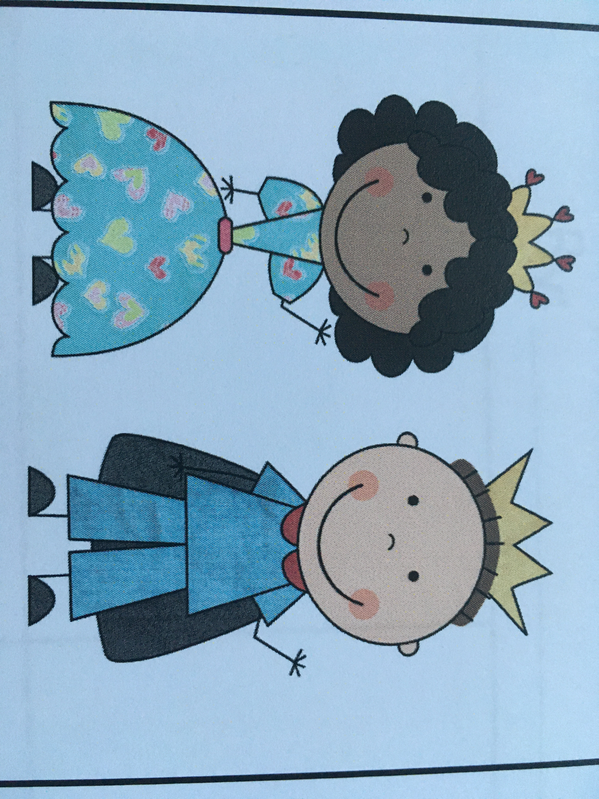
Parts of a fairy tale
Characters- Who were they? Who was good? Who was bad?
Notes:
I hope you enjoyed the story! Let’s talk about some of the things that are in this fairy tale and that we may find in other make-believe stories.
Characters are one thing that all fairy tales and make-believe stories have. Who were the characters in Jack and the Beanstalk? Yes- Jack. You got it- Mr. Peddler. Jack’s momma. Goose. Giant. Lady Giant. Were there good or bad?

Slide 6
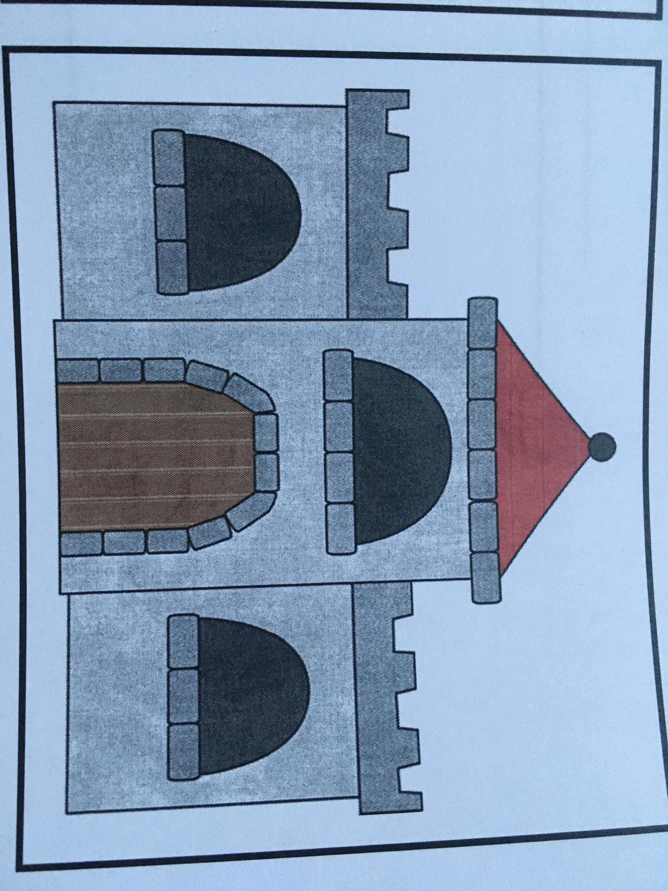
Parts of a fairy Tale
Setting- Where did this story take place?
Notes:
Another thing that this fairy tale and others have is a setting. The setting is where the story takes place. Who knows where this story takes place?
Great answers…Jack’s Farm, Giant’s Castle

Slide 7
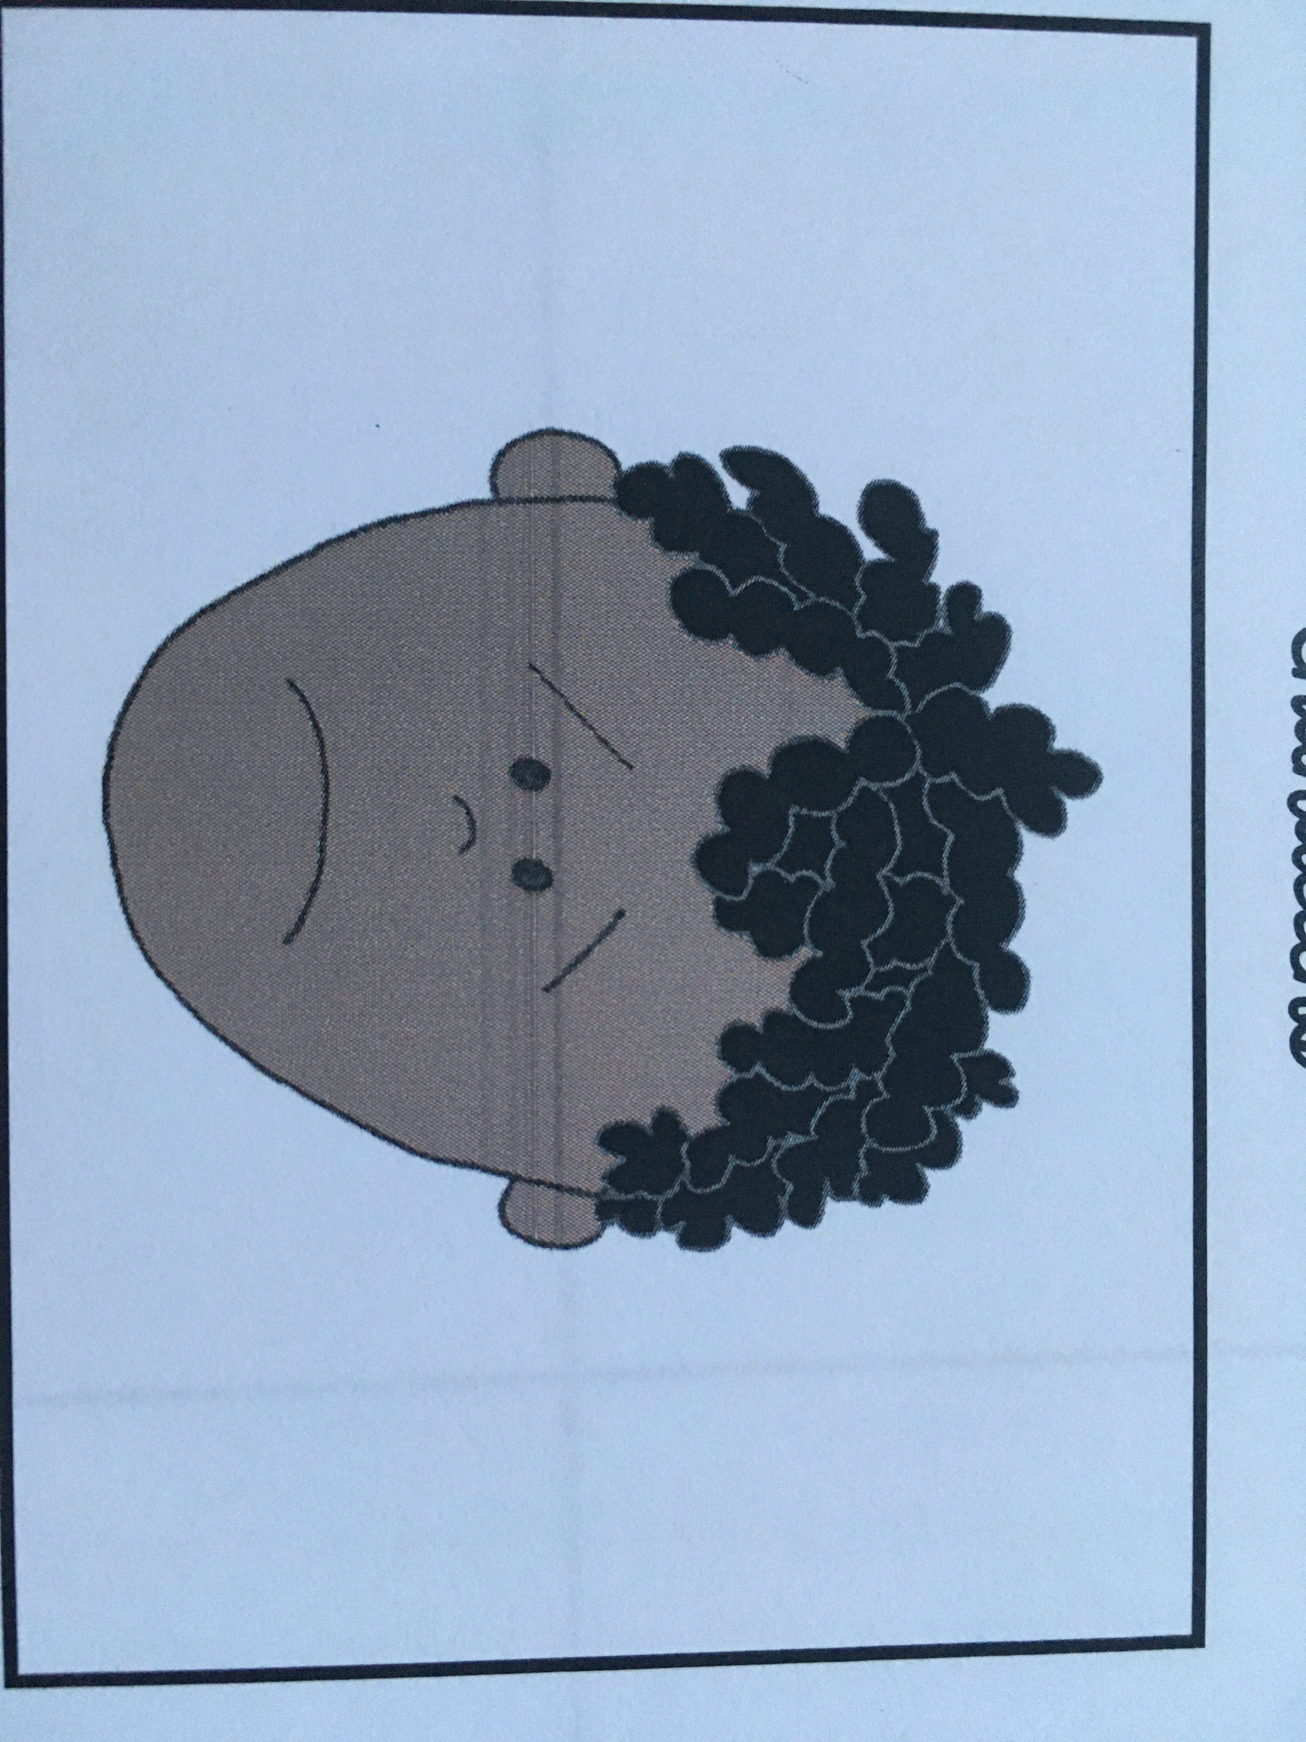
Parts of a fairy tale
A Problem- What was the problem in the story?
Notes:
This story and other fairy tales have a problem. What is the problem in this story?
Jack took the Giant’s goose.

Slide 8
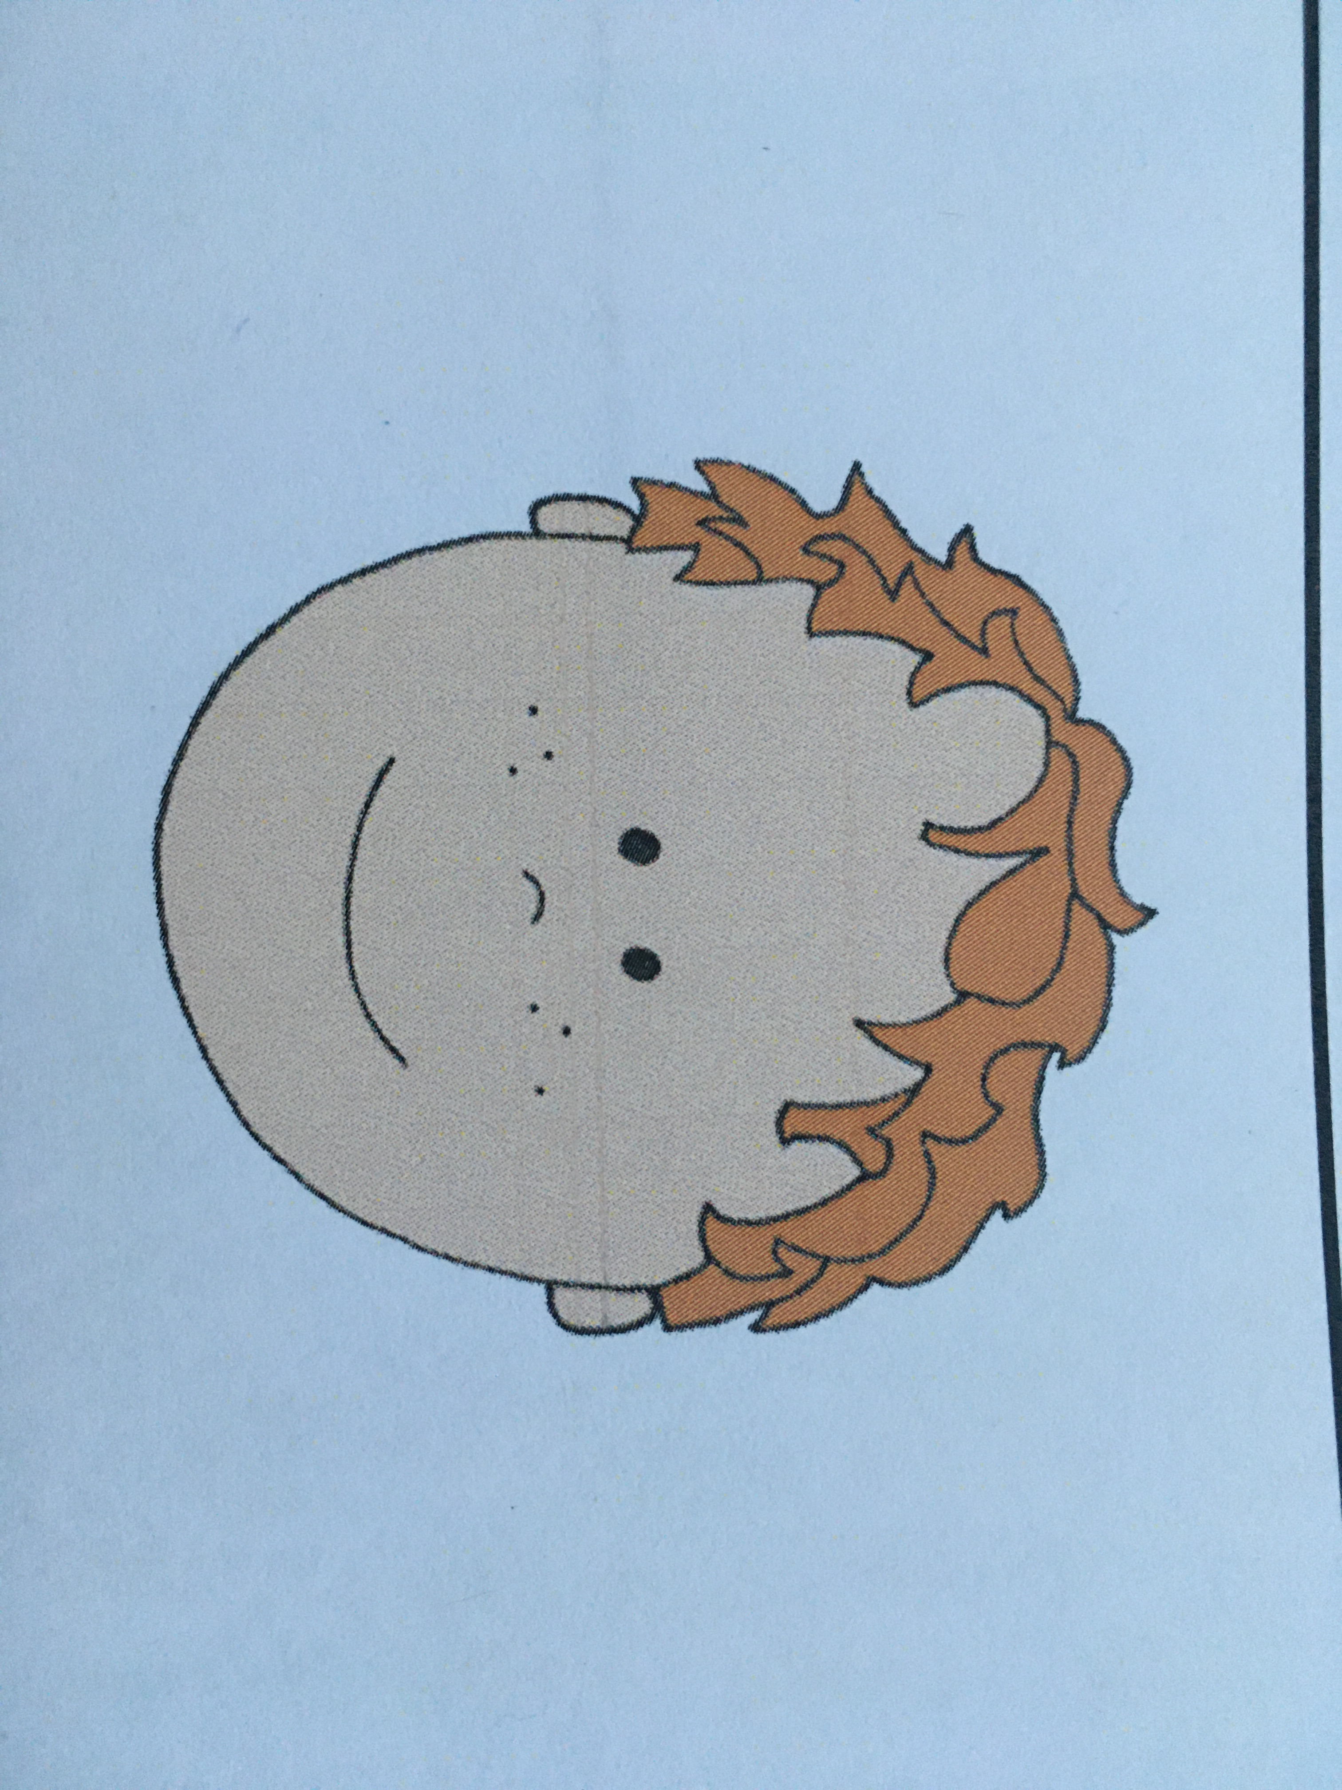
Parts of a fairy tale
Solution/Happy Ending- How was the problem solved?
Notes:
In this fairy tale and others, the problem is always resolved or fixed. This is called a solution. What was the solution to the problem in Jack and the Beanstalk.
They communicated with each other to get the goose back to the rightful owner and Jack apologizes.

Slide 9
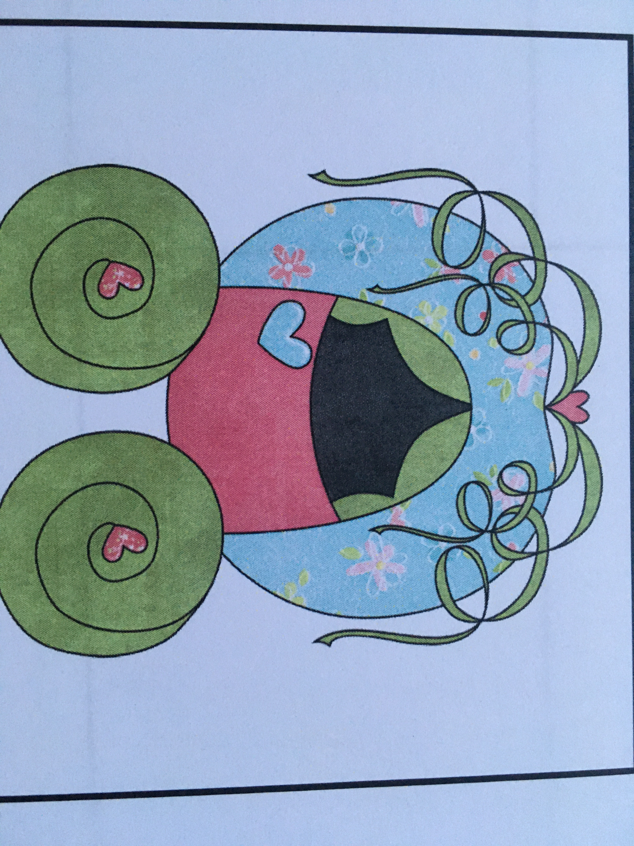
Parts of a fairy tale
Magic/Make Believe- What was magical in the story?
Notes:
One last thing that fairy tales usually have is magic or make-believe parts. There might be talking animals, a fairy godmother, or something else that couldn’t really happen in real life. What parts of this story were magic or make-believe? Awesome memory, yes Jack bought magic beans from the Mr. Peddler and climbed a huge beanstalk up to a castle in the clouds.

Slide 10
Find your Unit 5 Writing Booklet
Notes:
Ok writers! We just listened to a fairy tale and then talked about things that many fairy tales have. Since you will be writing fairy tales and make believe stories, you will want to include ALL of the things we just talked about in your stories. It’s time to get started, open your writing booklet which looks like this!

Slide 11
Find Page 11, it looks like this
Notes:
Turn to page 11 and you will see all the things that are in a fairy tale. You can use this page to help you remember what you need to add to your own make-believe story.

Slide 12
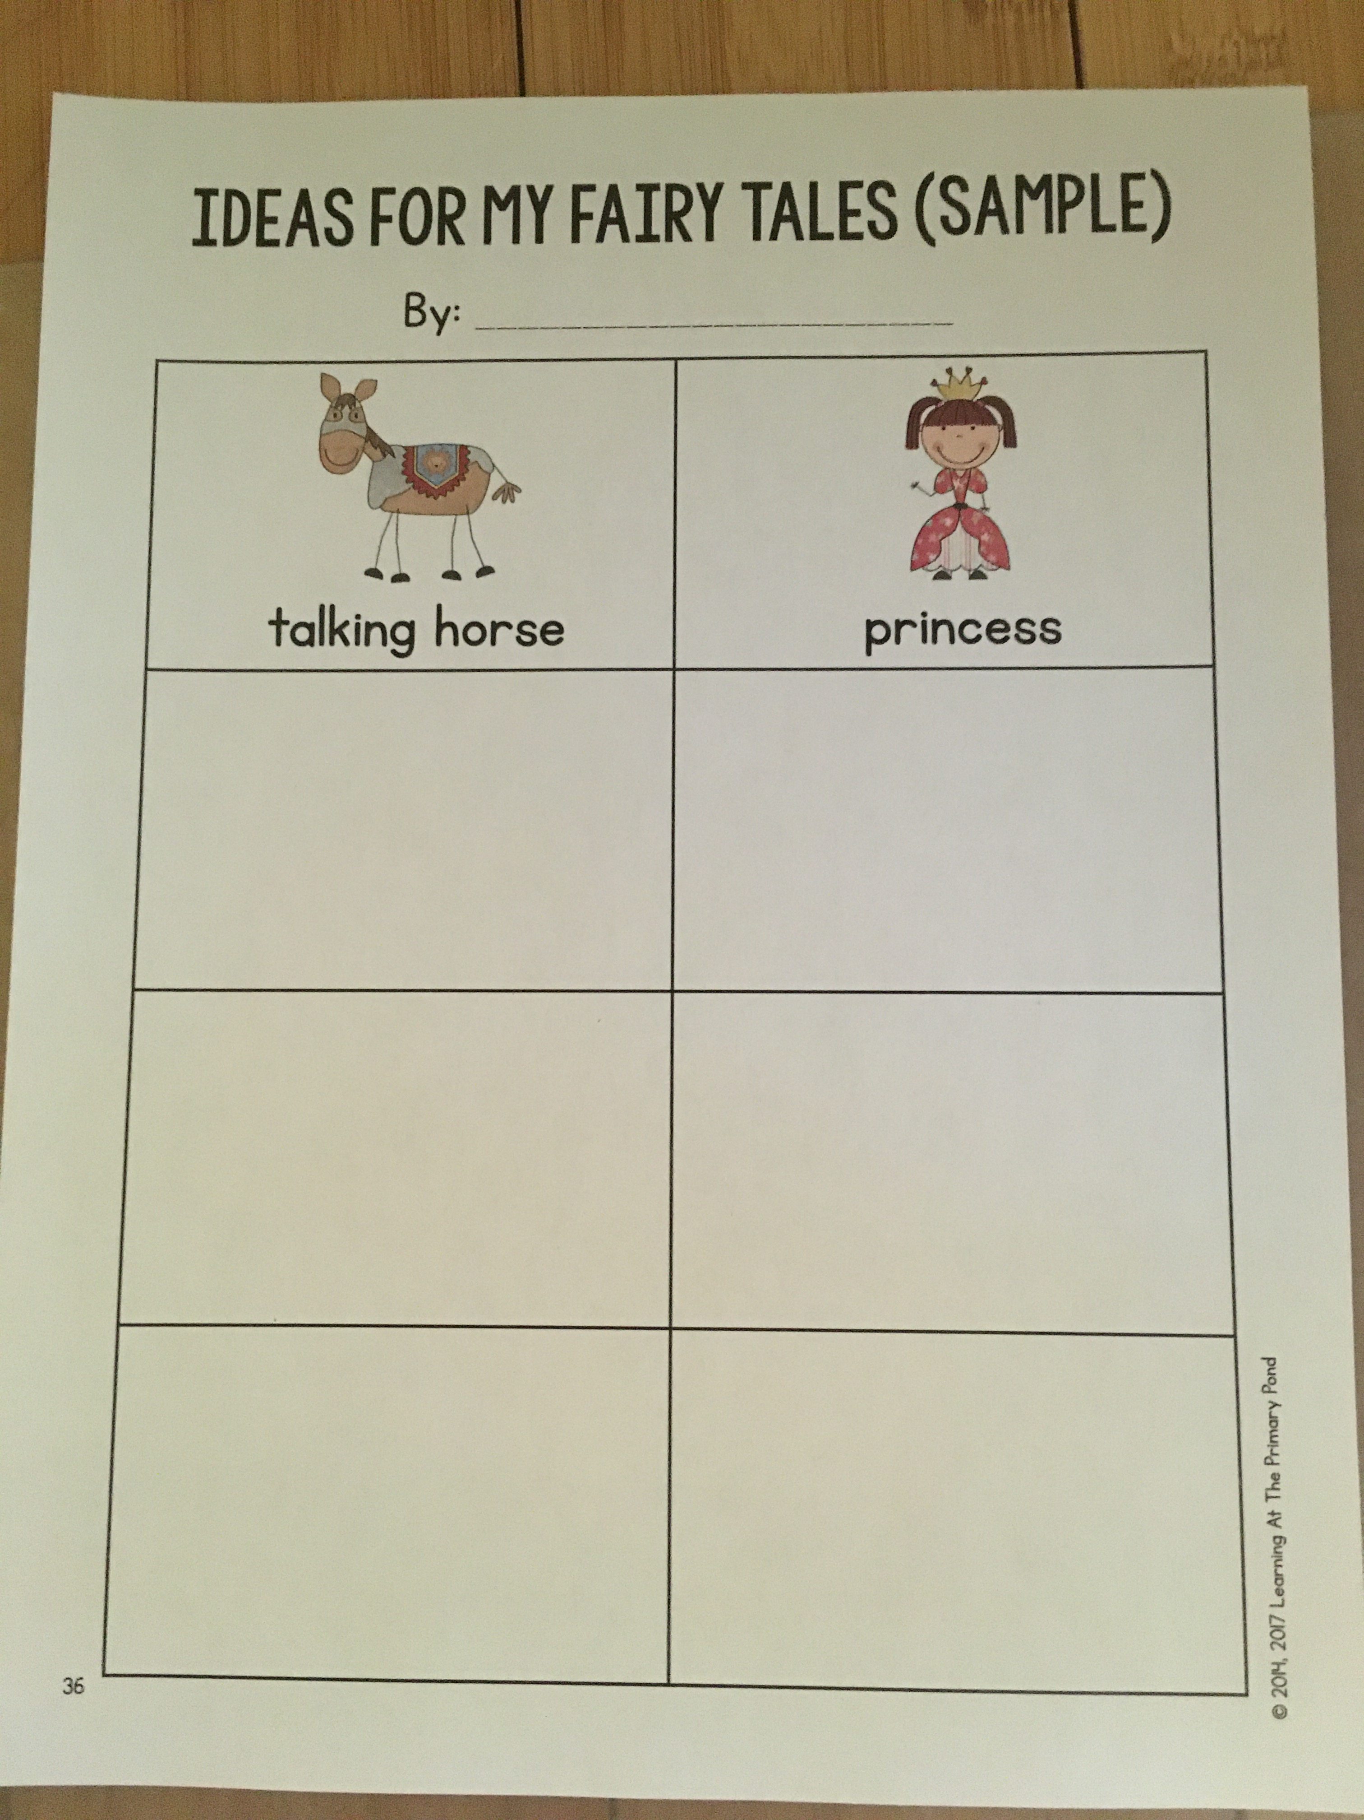
Let’s Brainstorm What do you want to add to your fairy tale story?
Notes:
Now, we will get ready to write our fairy tales and make-believe stories, by brainstorming! To brainstorm means to think of a lot of different ideas. We are going to brainstorm things that we would like to put in our fairy tales. Let me show you an example. A talking horse is an example of magic or make-believe that I want in my story, and a princess is an example of a character I want in my story. Remember that you have 5 things to include in your story, or maybe even more.

Slide 13
Your Turn!
Find this page in your writing folder
Notes:
Open your writing booklets to the page that looks like this! I can’t wait to see all the ideas you have for your fictional stories. Go ahead and get started writers!

