Slide 1
Writer’s Workshop Lesson #3
Writing the Beginning
Notes:
Hey, it’s Ms. A here. Welcome back Writer’s Workshop. Take a moment right now to grab your Unit 5 Writer’s Workshop booklet, pencil and eraser before we get started.

Slide 2
Notes:
Writer’s last time we were together you were in the planning stage of writing your fairy tale. The planning stage looks like that sheet being displayed, except yours will be filled with awesome ideas. Today, I am super excited because we are going to take our plans and write the beginning to our fairy tales!

Slide 3
How do fairy tales start?
Once upon a time in the middle of a thick forest stood a small cottage.
Once upon a time there lived an unhappy young girl.
Once there was a couple who had long in vain wished for a child.
Once upon a time on an old farm, lived a duck family, and Mother Duck had been sitting on a clutch of new eggs.
Notes:
So what does the beginning of a fairy tale look like?I’m sure most of you know the line you hear at the beginning of most fairy tales…let me read you some examples and see if you can find a pattern
Ya! Many fairy tales start out by saying “Once Upon a Time” or “Once there was”

Slide 4
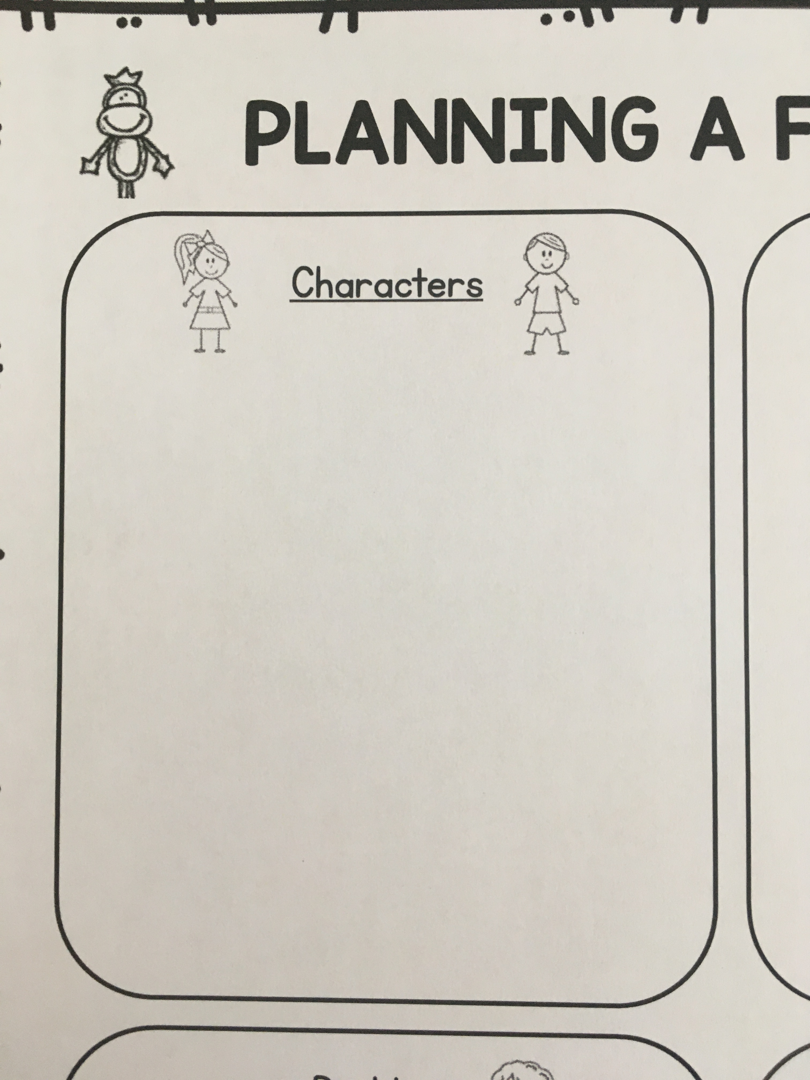
Sentence # 1- Once… + Main Character
Notes:
I want you to find one of these sheets at the back of your unit 5 booklet or some lined paper at home so we can get started. Let’s go ahead and start our first sentence, like the examples we just looked at. You can start with Once upon a time or Once there was, and finish the sentence by describing your main character. Don’t forget that you need to start all your sentences with a capital letter and end with punctuation.

Slide 5
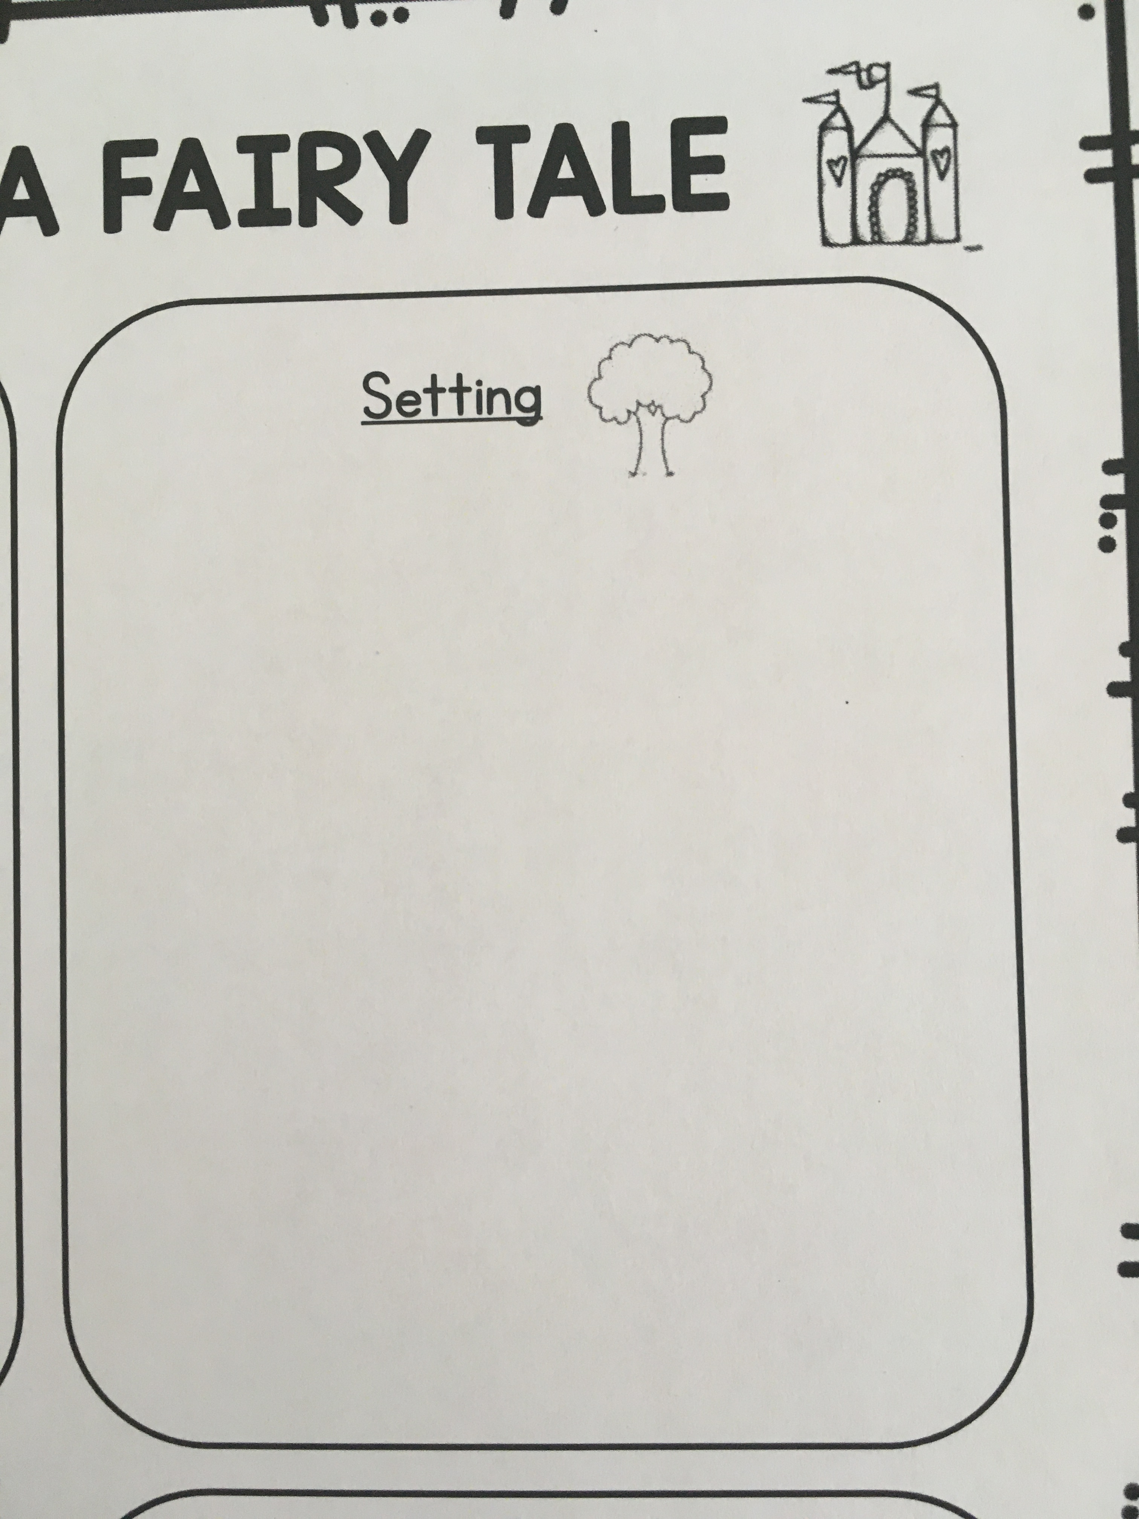
Sentence # 2- Describe the Setting
Notes:
Great work! Now that we’ve told our reader who the main character is, let’s describe the setting. We need to paint a picture in the reader’s mind so that the reader can really imagine what the place looks like. Remember to look back at your planning sheet to help you remember what setting you decided on. If you have lots to describe, then simply add more sentences.

Slide 6
What Is going to happen first?
Notes:
Our fairy tales are starting to look really good! It’s now time to put on our thinking caps and decide what is going to happen first in your story. You have already decided what your problem is going to be, but we can’t start writing about that quite yet or our story will be over too quickly.
Let’s look at an example together. I want to pay close attention to see if afterwards you can name the main character, the setting, and what happens first.

Slide 7
Your turn
Minimum of 3 sentences
1. ”Once…” and main character
2. Setting with detail
3. What happens first
You can do it!
Notes:
Ok writer’s, I’m glad you paid close attention and were able to point out those 3 things.
Now it’s your turn to write what happens first in your own fairy tale. By the end of today you should have a minimum of 3 sentences in your fairy tale that describe the following.
I’m excited to see what you come up with, You can do this!

