Slide 1
Writer’s Workshop Lesson # 5
Writing the End

Slide 2
Parts of a Fairy Tale

Slide 3
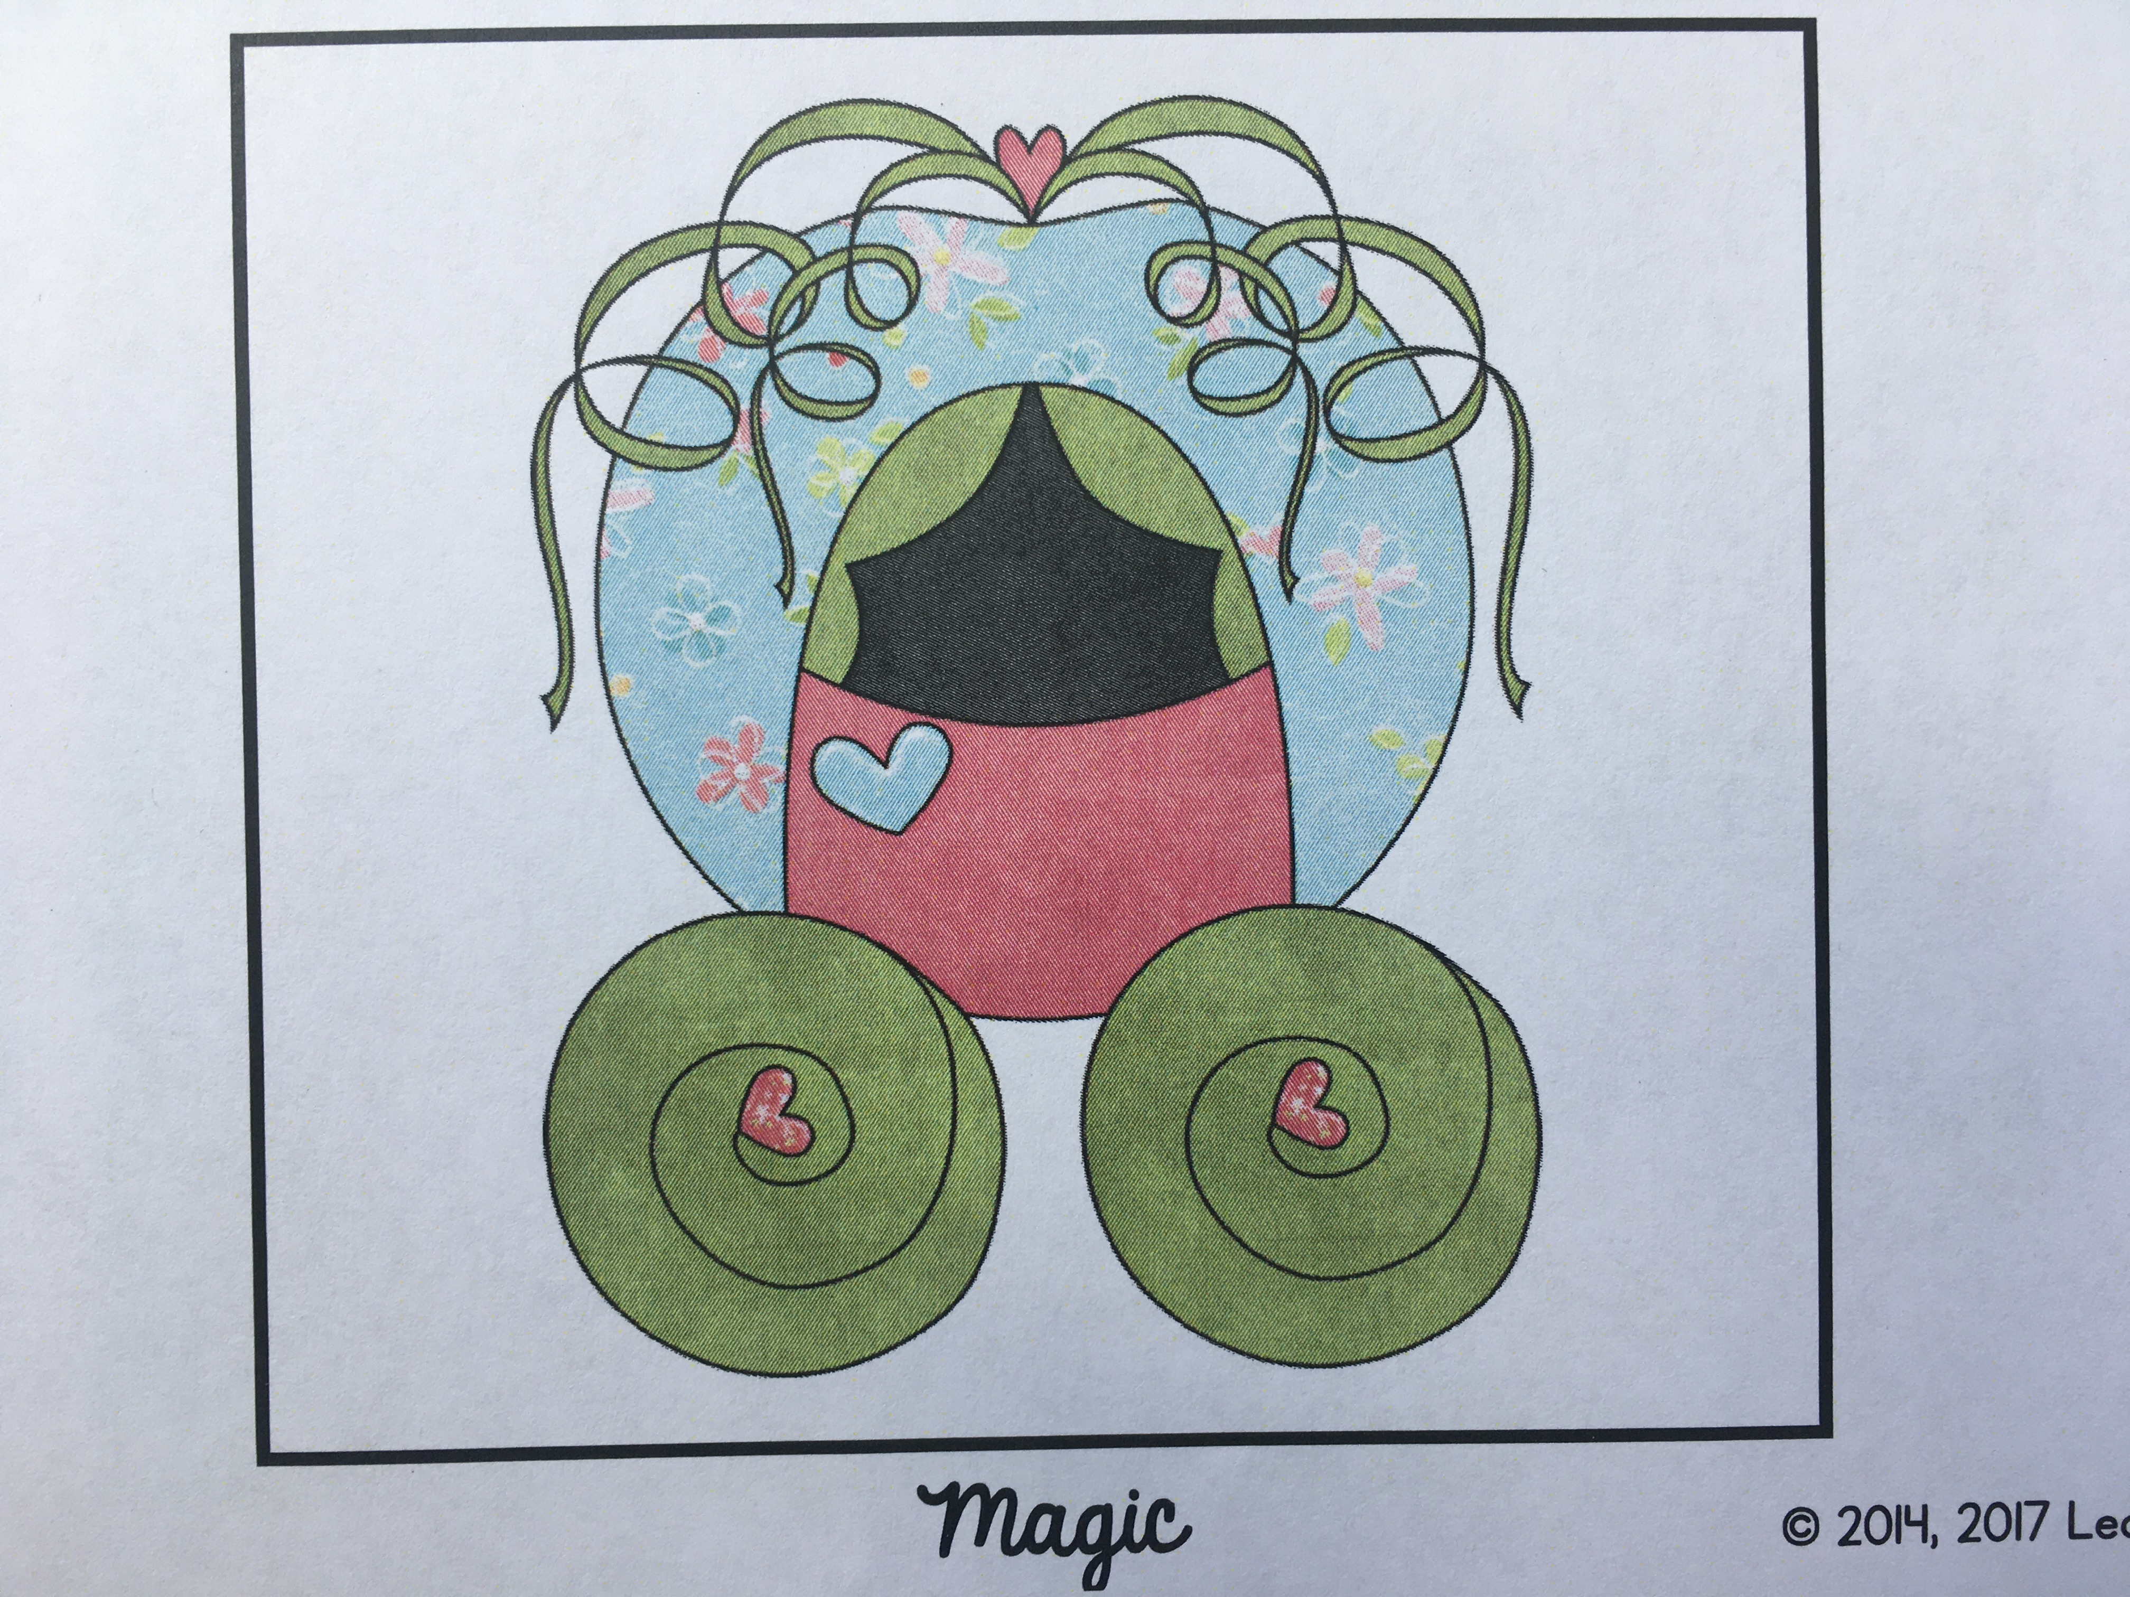
Writing the End

Slide 4
Writing the end
You’ve got this!

Slide 5
Beginning, Middle, and End
Beginning (introduce characters and setting)
Middle (tell what the problem is and have characters try to solve it)
End (have the characters solve the problem…happy ever after)

Slide 6
Writing the end
Chat with you next time!
-Ms. A

