Slide 1
Writer’s Workshop Lesson #4
Writing the Middle
Notes:
Hey there Grade 2s, it’s Ms. A here and thanks for joining me for our Writer’s Workshop Lesson # 4 on Writing the middle of your fairy tale.

Slide 2
Notes:
Writers, last time we were together you wrote the beginning to your fairy tale. Today we are going to continue our story and write the middle part. Before we pick up our pencils, I want you to refresh your memory by re-reading the part your wrote last time. I am going to give you some time to do that right now.

Slide 3
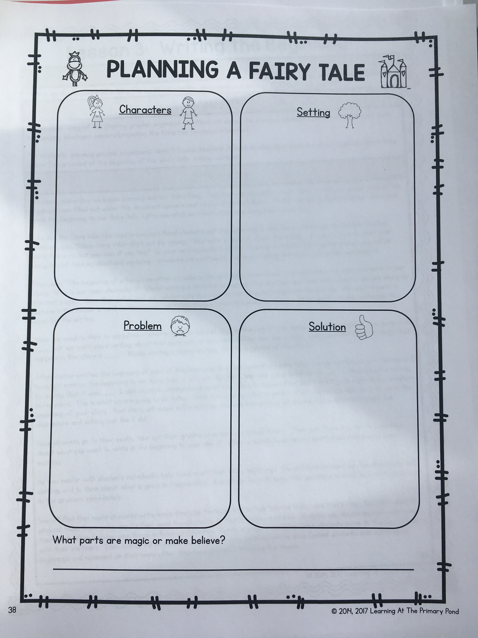
Notes:
Ok, great work. So after a beginning comes a middle. In the middle of a fairy tale, the author always tells the reader what the problem is. Let’s look at our organizer from a few days ago, the page that is on your screen, and remind ourselves what we planned as our problem.
So we know that our fairy tale has to build up to this problem, so before we can introduce the problem what do you think should happen?

Slide 4
Notes:
Here is an example of a 2 sentence build up before the problem gets introduced. Notice that I have started a new paragraph to separate the beginning from the middle.
The build up says…
I want you to pick up your pencil, start a new paragraph with a capital letter and write 2-4 sentences to build up or lead up to your problem.

Slide 5
Transitional words
Suddenly, Rose was spooked and took off into the deep, dark forest.
Later on, Eli came back to visit Rose but she wasn’t where he left her.
Next, as Eli began to feed Rose another carrot, she escaped his grip and began running towards the forest.
Notes:
After the build up to our problem we can use transitional words to introduce the problem. Some examples are shown on the screen in front of you. Here are some ways I’m thinking about introducing the problem using transitional words.
Give it a try and see if any of these transitional words help you introduce your problem.

Slide 6
Notes:
So now that your main character has a problem, he or she is going to try and solve it right? I know you have all already brainstormed your solutions but I think we should have our character try a few solutions that don’t work which will keep our readers in suspense. Our readers will want to keep reading in order to find out the real solution to our problem.

Slide 7
The middle should include:
2-4 sentences for a build up
Transitional words to introduce problem
2-4 ways your main character TRIES to solve the problem but does not succeed
Notes:
By the end of today I want you to have 2-4 sentences for a build up, transitional words to introduce your problem and 2-4 ways to solve their problem, but DON’T solve it yet. That will be in our next lesson when we talk about how to write the end of your fairy tale.
Happy writing! Get creative and have fun with how your main character tries o solve the problem. I can’t wait for you to read me some of your work on our next Zoom chat. Talk to you all again soon. Miss you.

