Slide 1
Writer’s Workshop lesson # 10
Using temporal (Time) words

Slide 2
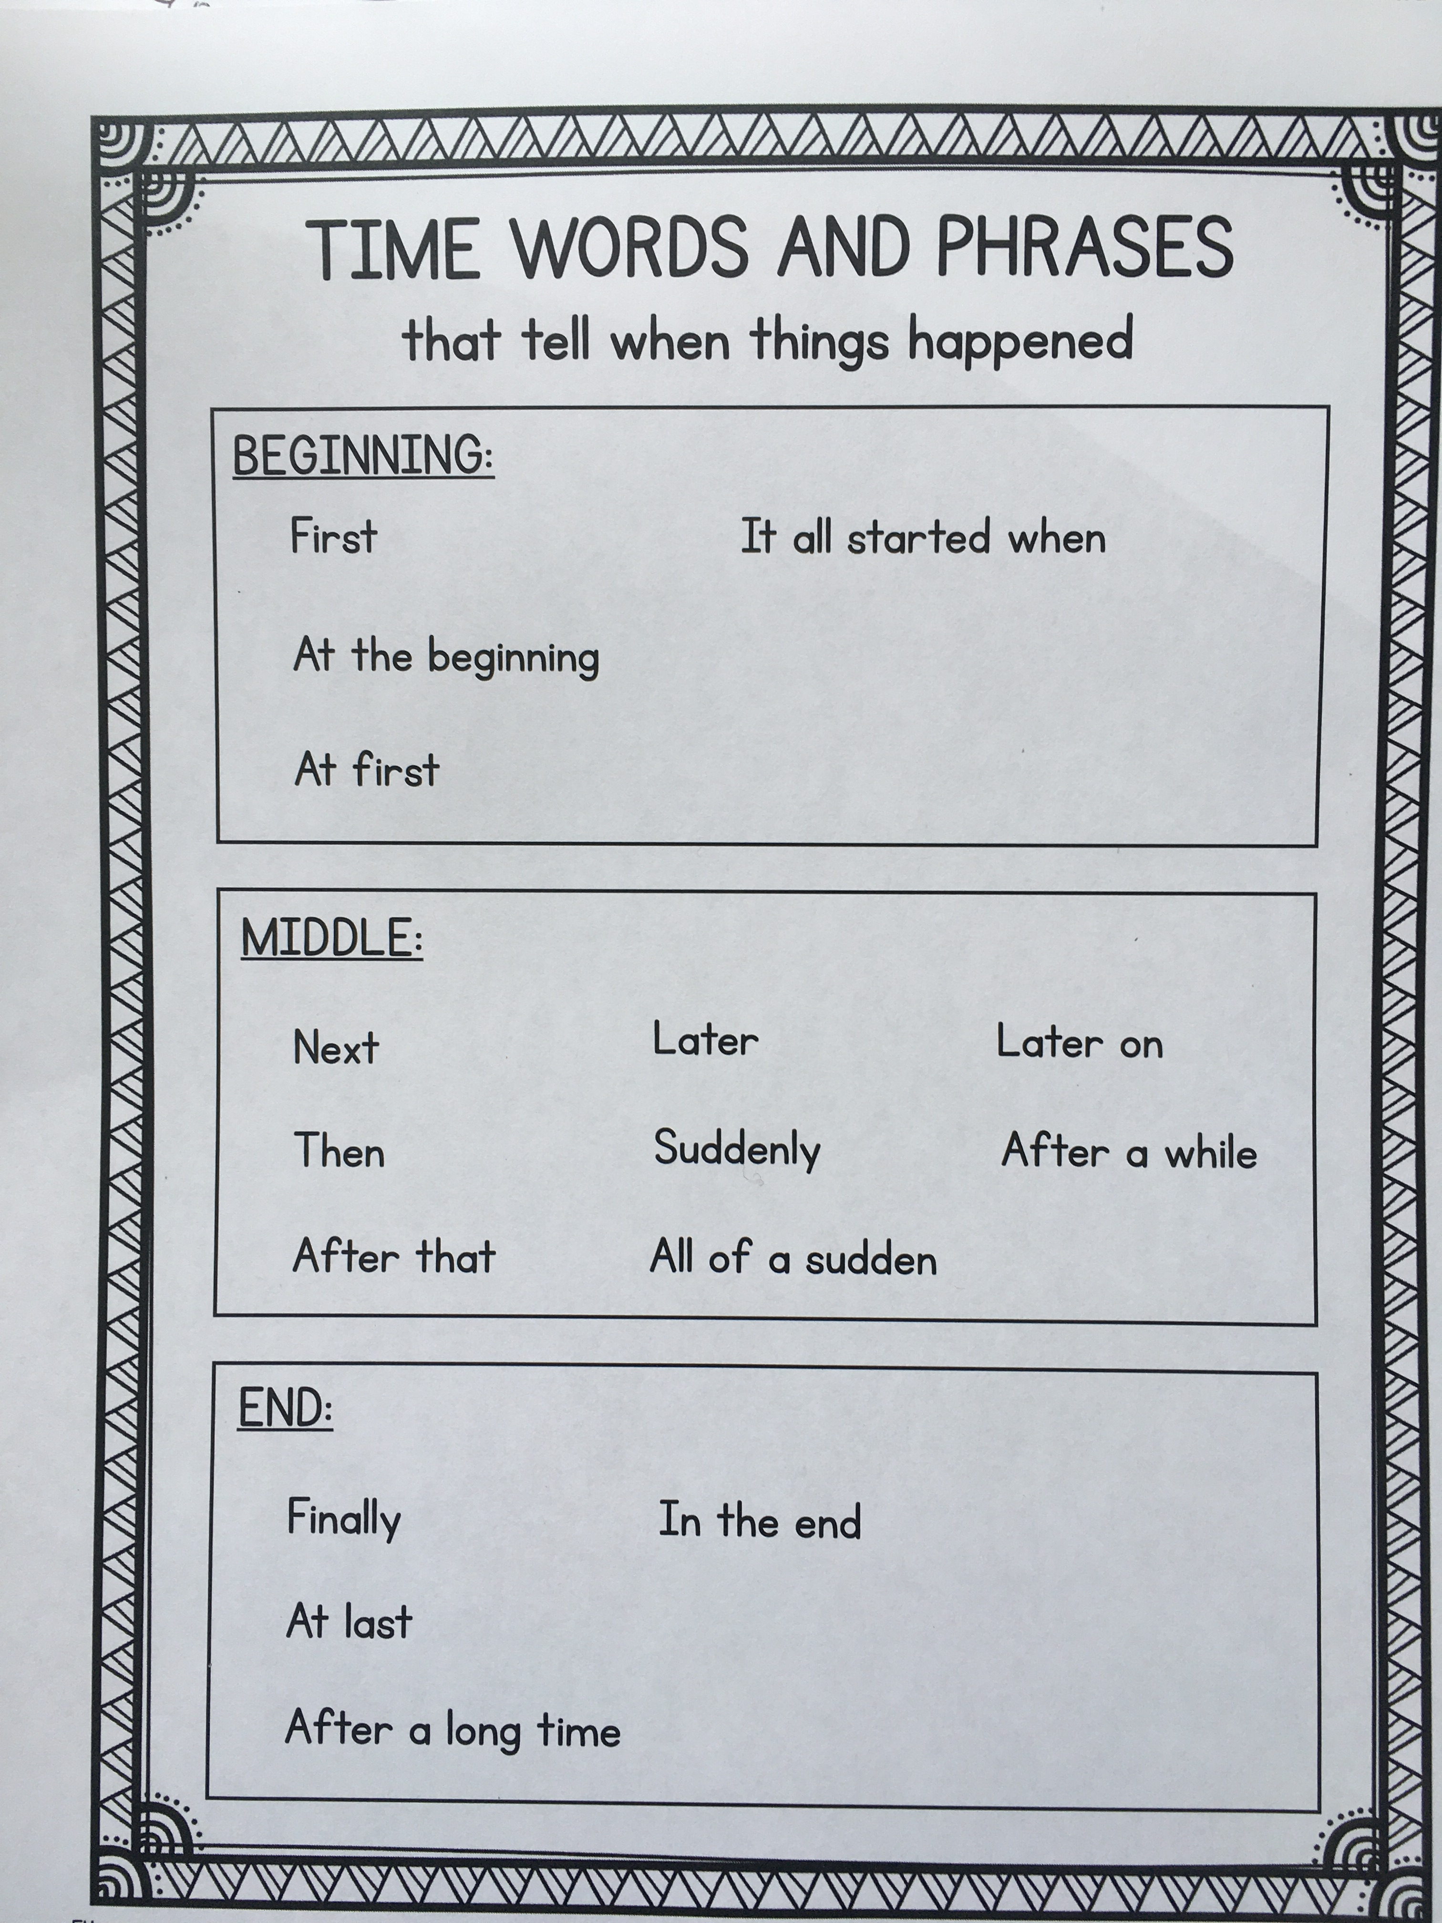

Slide 4
SCAVENGER HUNT
Beginning –introduce the characters and setting
Middle- tell what the problem is and have the characters TRY to solve it but not succeed
End- have the characters solve the problem

Slide 5
ADD TO YOUR FAIRY TALE
Beginning –introduce the characters and setting
Middle- tell what the problem is and have the characters TRY to solve it but not succeed
End- have the characters solve the problem

