Slide 1
Writer’s Workshop Lesson #11
Narrative rubric

Slide 4
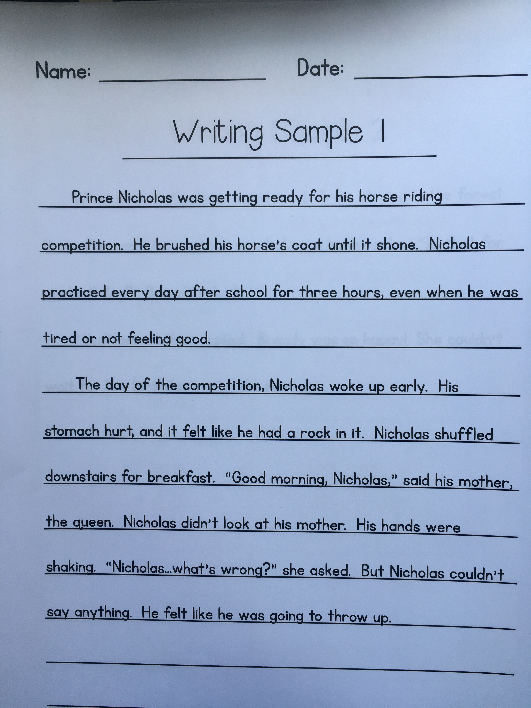
Take out your fairy tale

Slide 5
Take out your fairy tale

Slide 6
Take out your fairy tale

Slide 7
Take out your fairy tale

Slide 8
Take out your fairy tale

Slide 9
Thanks for being honest

