Slide 1
Writer’s Workshop Lesson #12
Reflecting on my story writing

Slide 2
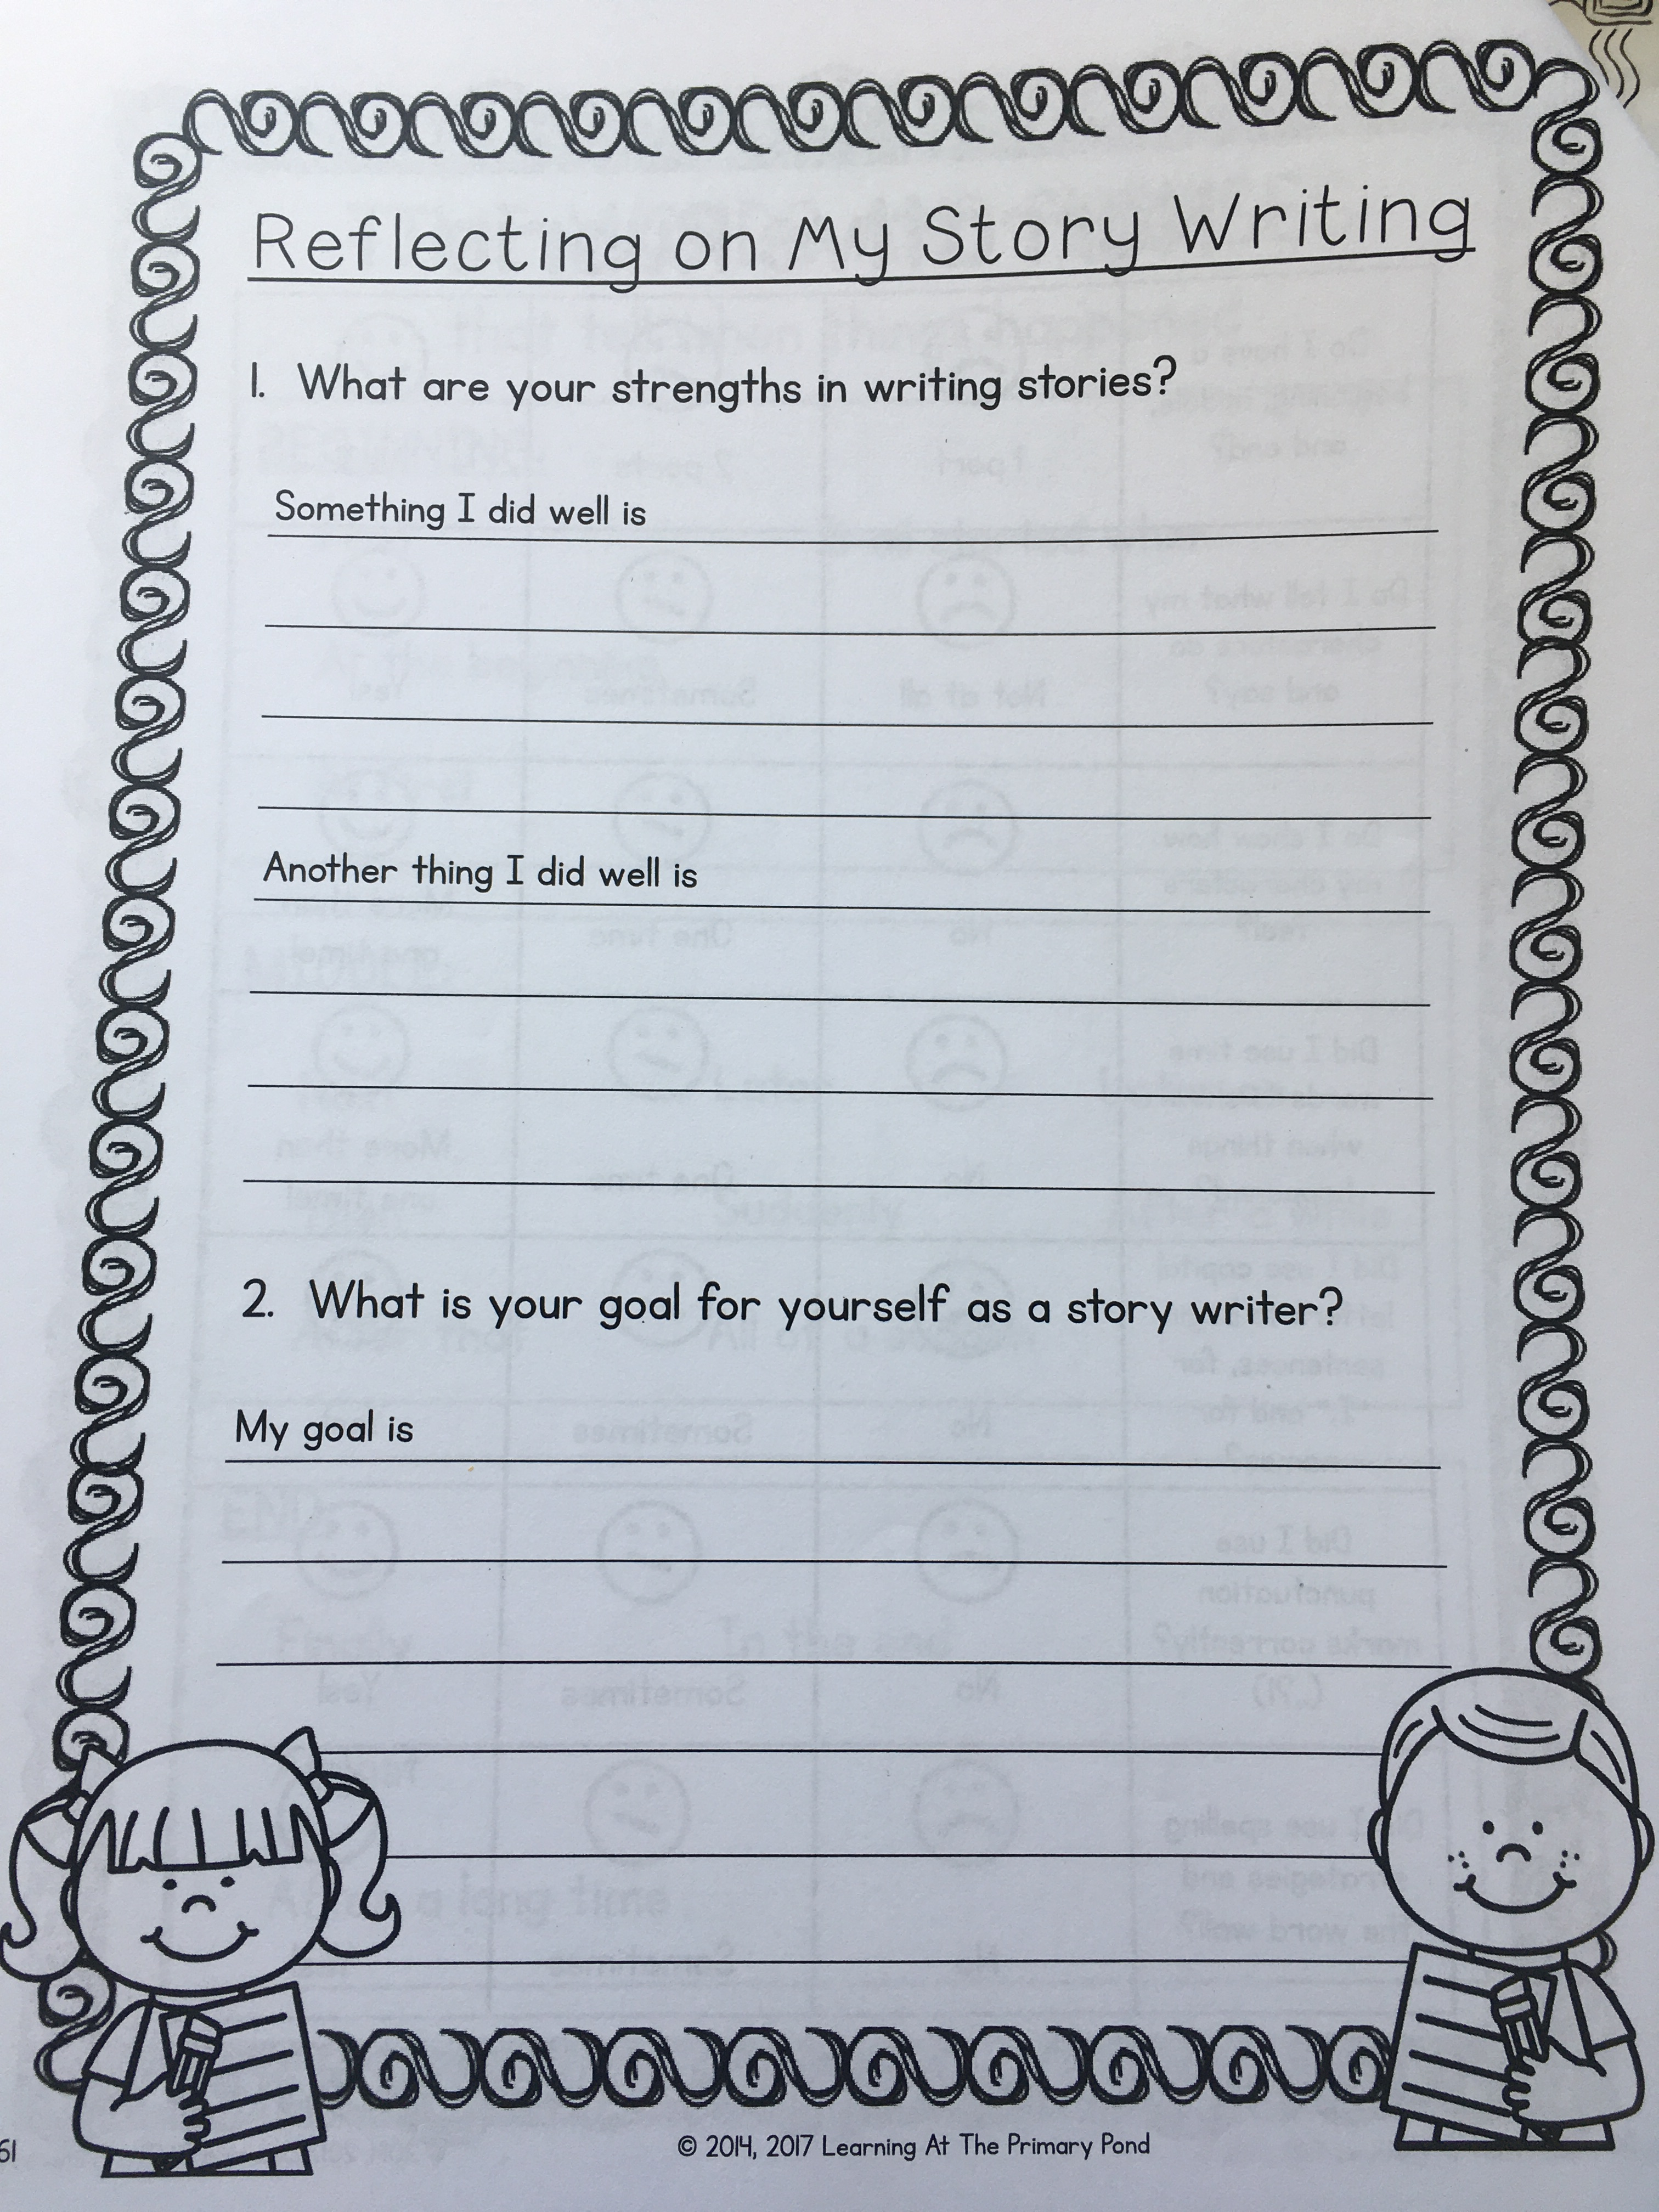

Slide 6
We have completed unit 5!

